Slide 1
Mehran S. Fallah April 2020
Discrete Mathematics
Session V
Generating Functions

Slide 2
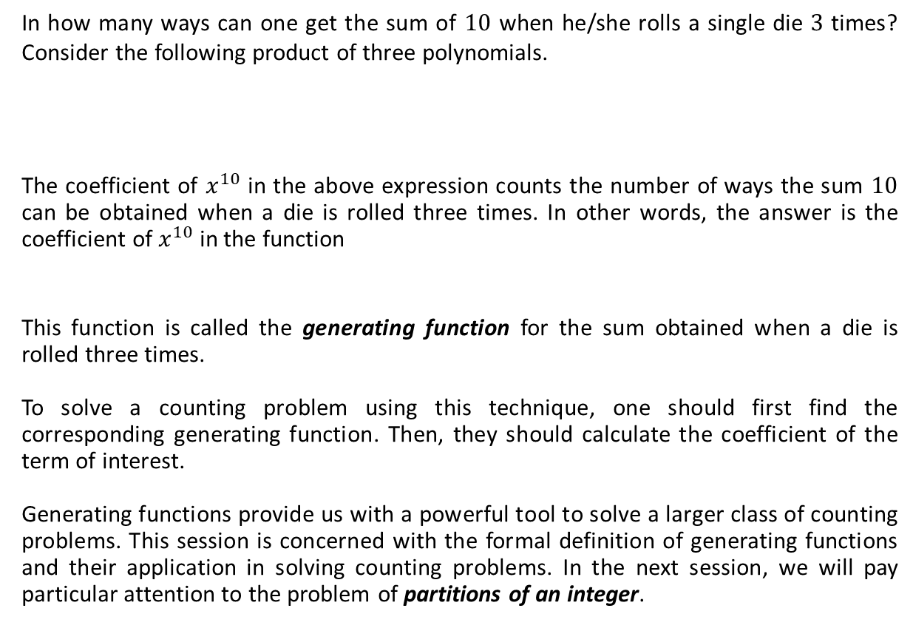
Introduction
In how many ways can one get the sum of $10$ when he/she rolls a single die $3$ times? Consider the following product of three polynomials.
The coefficient of $x^{10}$ in the above expression counts the number of ways the sum $10$ can be obtained when a die is rolled three times. In other words, the answer is the coefficient of $x^{10}$ in the function
This function is called the generating function for the sum obtained when a die is rolled three times.
To solve a counting problem using this technique, one should first find the corresponding generating function. Then, they should calculate the coefficient of the term of interest.
Generating functions provide us with a powerful tool to solve a larger class of counting problems. This session is concerned with the formal definition of generating functions and their application in solving counting problems. In the next session, we will pay particular attention to the problem of partitions of an integer.
$$(x+x^{2}+x^{3}+x^{4}+x^{5}+x^{6})(x+x^{2}+x^{3}+x^{4}+x^{5}+x^{6})(x+x^{2}+x^{3}+x^{4}+x^{5}+x^{6})$$
$$=x^{3}+x^{4}+…+x^{10}+…+x^{10}+…+x^{17}+x^{18}=x^{3}+…+Cx^{10}+…+x^{18}$$
$$f\left(x\right)={\left(x+x^{2}+x^{3}+x^{4}+x^{5}+x^{6}\right)}^{3}.$$

Slide 3





Some Motivating Examples
Example 1. Give the generating function for the number of n-element subsets of an m-element set.
Solution. The coefficient of $x^{n}$ in the following function is the number of n-element subsets of an m-element set $A=\{a_{1},a_{2},…, a_{m}\}$.
From the binomial theorem, we have
The coefficient of $x^{n}$ in $f(x)$ is $\left(\begin{matrix}m \\ n\end{matrix}\right)$ for $0≤n≤m$ and $0$ otherwise.
Example 2. Give a generating function and indicate the coefficient that is needed to find the number of integer solutions to $x_{1}+x_{2}+x_{3}+x_{4}=20$ where $0≤x_{i}$ for $1≤i≤4$, $x_{2}$ is even and $x_{3}$ is odd.
Solution. The answer is the coefficient of $x^{20}$ in either of the following functions
$$f\left(x\right)=\left(1+x\right)\left(1+x\right)⋯\left(1+x\right)={\left(1+x\right)}^{m}.$$
$$f\left(x\right)=\sum_{i=0}^{m}{\left(\begin{matrix}m \\ i\end{matrix}\right){1^{i}⋅x}^{m−i}}=\sum_{i=0}^{m}{\left(\begin{matrix}m \\ m−i\end{matrix}\right)x^{m−i}=\sum_{k=0}^{m}{\left(\begin{matrix}m \\ k\end{matrix}\right)x^{k}}}.$$
factors for $x_{1}$ and $x_{4}$
factor for $x_{2}$
factor for $x_{3}$
$$f\left(x\right)={\left(1+x+x^{2}+…+x^{20}\right)}^{2} \left(1+x^{2}+x^{4}+…+x^{20}\right) (x+x^{3}+x^{5}+…+x^{19})$$
$$g\left(x\right)={\left(1+x+x^{2}+…\right)}^{2}(1+x^{2}+x^{4}+…)(x+x^{3}+x^{5}+…)$$

Slide 4


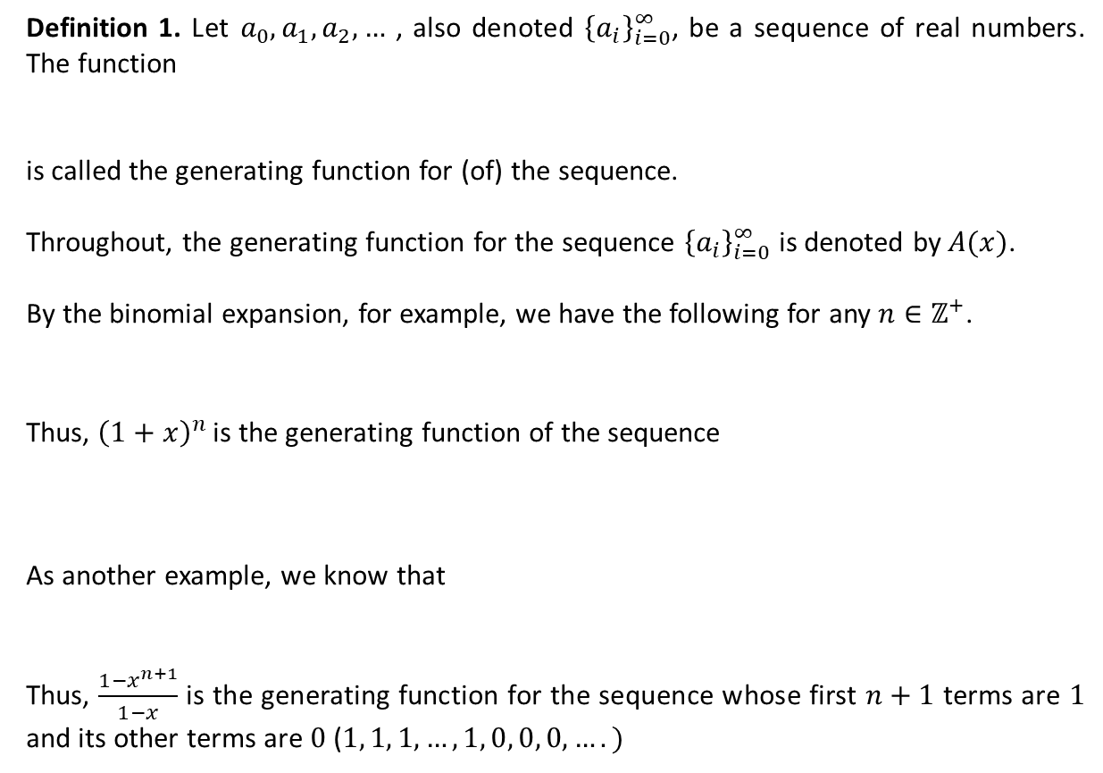

Generating Functions
Definition 1. Let $a_{0}, a_{1},a_{2}, …$ , also denoted ${\left\{a_{i}\right\}}_{i=0}^{∞}$, be a sequence of real numbers. The function
is called the generating function for (of) the sequence.
Throughout, the generating function for the sequence ${\left\{a_{i}\right\}}_{i=0}^{∞}$ is denoted by $A(x)$.
By the binomial expansion, for example, we have the following for any $n∈ℤ^{+}$.
Thus, ${\left(1+x\right)}^{n}$ is the generating function of the sequence
As another example, we know that
Thus, $\frac{1−x^{n+1}}{1−x}$ is the generating function for the sequence whose first $n+1$ terms are $1$ and its other terms are $0$($1, 1, 1, …,1, 0, 0, 0, ….)$
$$a_{0}+a_{1}x+a_{2}x^{2}+…=\sum_{i=0}^{∞}{a_{i}x^{i}}$$
$${\left(1+x\right)}^{n}=\left(\begin{matrix}n \\ 0\end{matrix}\right)+\left(\begin{matrix}n \\ 1\end{matrix}\right)x+\left(\begin{matrix}n \\ 2\end{matrix}\right)x^{2}+…+\left(\begin{matrix}n \\ n\end{matrix}\right)x^{n}$$
$$\left(\begin{matrix}n \\ 0\end{matrix}\right), \left(\begin{matrix}n \\ 1\end{matrix}\right), \left(\begin{matrix}n \\ 2\end{matrix}\right), …, \left(\begin{matrix}n \\ n\end{matrix}\right), 0, 0, 0,….$$
$$\frac{1−x^{n+1}}{1−x}=1+x+x^{2}+…+x^{n}.$$

Slide 5

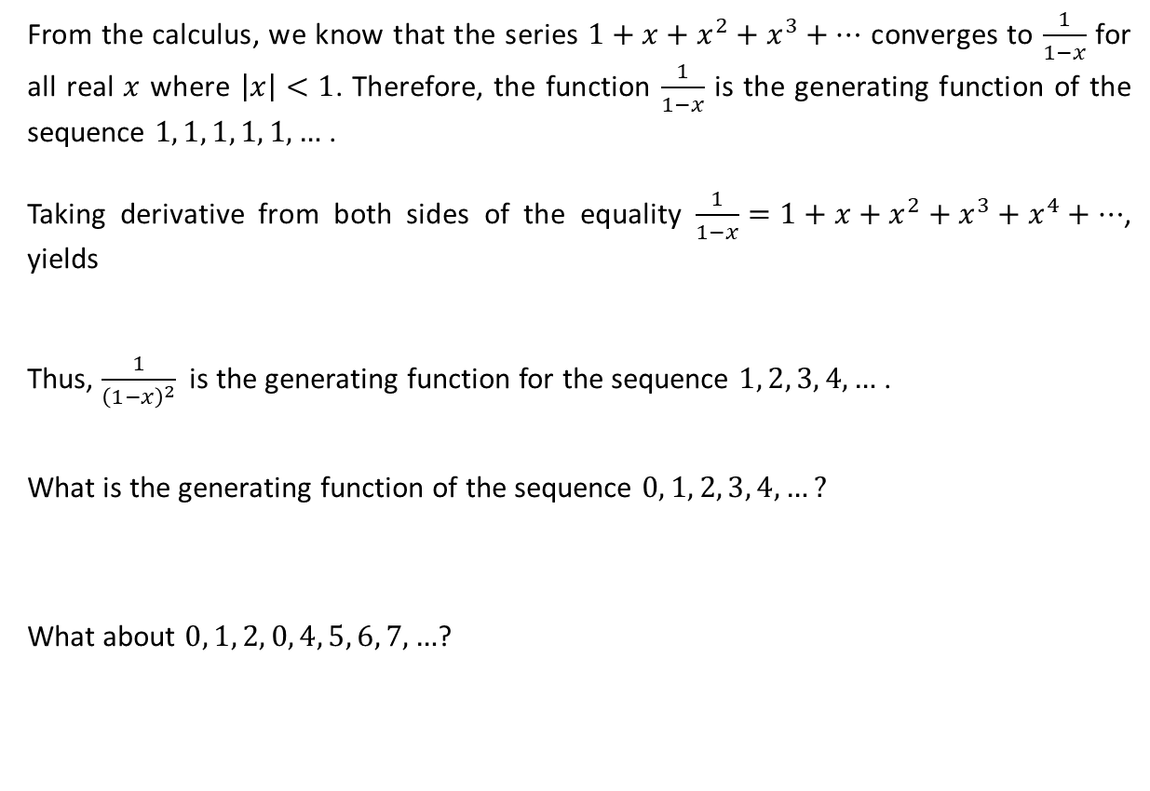


Generating Functions (Ctd.)
From the calculus, we know that the series $1+x+x^{2}+x^{3}+…$ converges to $\frac{1}{1−x}$ for all real $x$ where $\left|x\right|<1$. Therefore, the function $\frac{1}{1−x}$ is the generating function of the sequence $1, 1, 1, 1, 1, …$ .
Taking derivative from both sides of the equality $\frac{1}{1−x}=1+x+x^{2}+x^{3}+x^{4}+…$, yields
Thus, $\frac{1}{{\left(1−x\right)}^{2}}$ is the generating function for the sequence $1, 2, 3, 4, …$ .
What is the generating function of the sequence $0, 1, 2, 3, 4, …?$
What about $0, 1, 2, 0, 4, 5, 6, 7, …$?
$$\frac{1}{{\left(1−x\right)}^{2}}=1+2x+3x^{2}+4x^{3}+…$$
$$x+2x^{2}+3x^{3}+4x^{4}+…=\frac{x}{{\left(1−x\right)}^{2}}.$$
$$\frac{x}{{\left(1−x\right)}^{2}}−3x^{3}$$

Slide 6


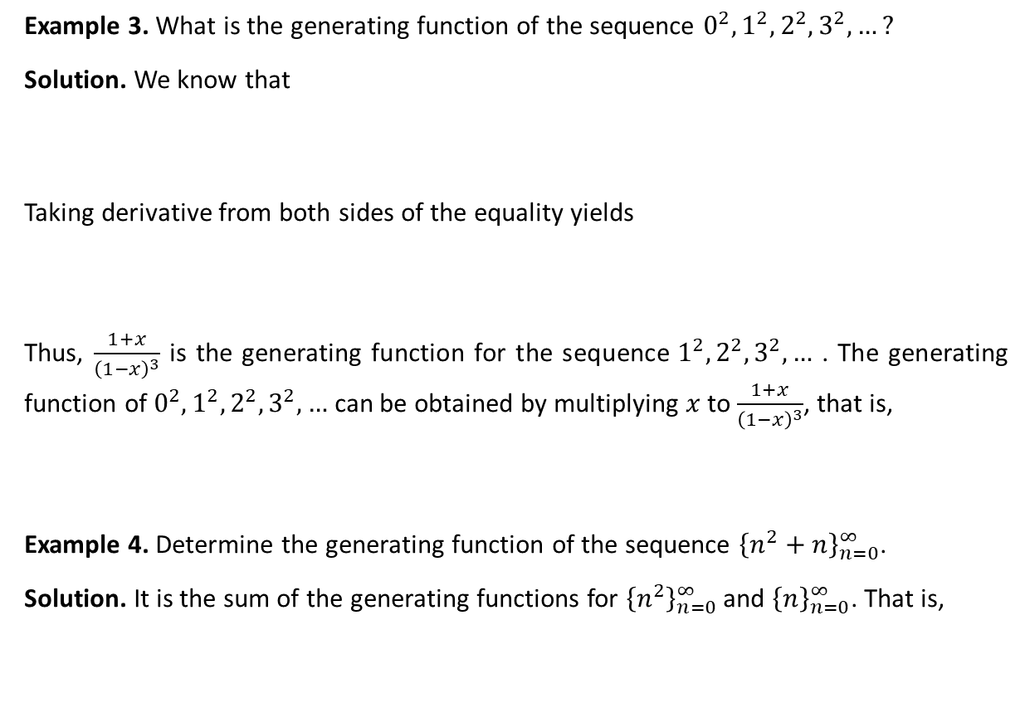


Generating Functions (Ctd.)
Example 3. What is the generating function of the sequence $0^{2}, 1^{2}, 2^{2}, 3^{2}, …?$
Solution. We know that
Taking derivative from both sides of the equality yields
Thus, $\frac{1+x}{{\left(1−x\right)}^{3}}$ is the generating function for the sequence${ 1}^{2}, 2^{2}, 3^{2}, …$ . The generating function of $0^{2}, 1^{2}, 2^{2}, 3^{2}, …$ can be obtained by multiplying $x$ to $\frac{1+x}{{\left(1−x\right)}^{3}}$, that is,
Example 4. Determine the generating function of the sequence ${\left\{n^{2}+n\right\}}_{n=0}^{∞}$.
Solution. It is the sum of the generating functions for ${\left\{n^{2}\right\}}_{n=0}^{∞}$ and ${\left\{n\right\}}_{n=0}^{∞}$. That is,
$$\frac{x}{{\left(1−x\right)}^{2}}=x+2x^{2}+3x^{3}+4x^{4}+…$$
$$\frac{1+x}{{\left(1−x\right)}^{3}}=1^{2}+2^{2}x+3^{2}x^{2}+4^{2}x^{4}+…$$
$$\frac{x(1+x)}{{\left(1−x\right)}^{3}}.$$
$$\frac{x(1+x)}{{\left(1−x\right)}^{3}}+\frac{x}{{\left(1−x\right)}^{2}}=\frac{2x}{{\left(1−x\right)}^{3}}$$

Slide 7






Generating Functions (Ctd.)
For $n, r∈ℤ^{+}$, we have
For $α∈ℝ$ and $r∈ℤ^{+}$, we use the notation $\left(\begin{matrix}α \\ r\end{matrix}\right)$ for
Moreover, we define $\left(\begin{matrix}α \\ 0\end{matrix}\right)=1$ for each real number $α$.
In particular, for $n, r∈ℤ^{+}$,
$$\left(\begin{matrix}n \\ r\end{matrix}\right)=\frac{n\left(n−1\right)\left(n−2\right)⋯(n−r+1)}{r!}.$$
$$\frac{α\left(α−1\right)\left(α−2\right)⋯(α−r+1)}{r!}.$$
$$\left(\begin{matrix}−n \\ r\end{matrix}\right)=\frac{−n\left(−n−1\right)\left(−n−2\right)⋯(−n−r+1)}{r!}.$$
$$={\left(−1\right)}^{r}\frac{n\left(n+1\right)\left(n+2\right)⋯(n+r−1)}{r!}.$$
$$={\left(−1\right)}^{r}\frac{(n+r−1))!}{r!\left(n−1\right)!}={\left(−1\right)}^{r}\left(\begin{matrix}n+r−1 \\ r\end{matrix}\right)$$

Slide 8
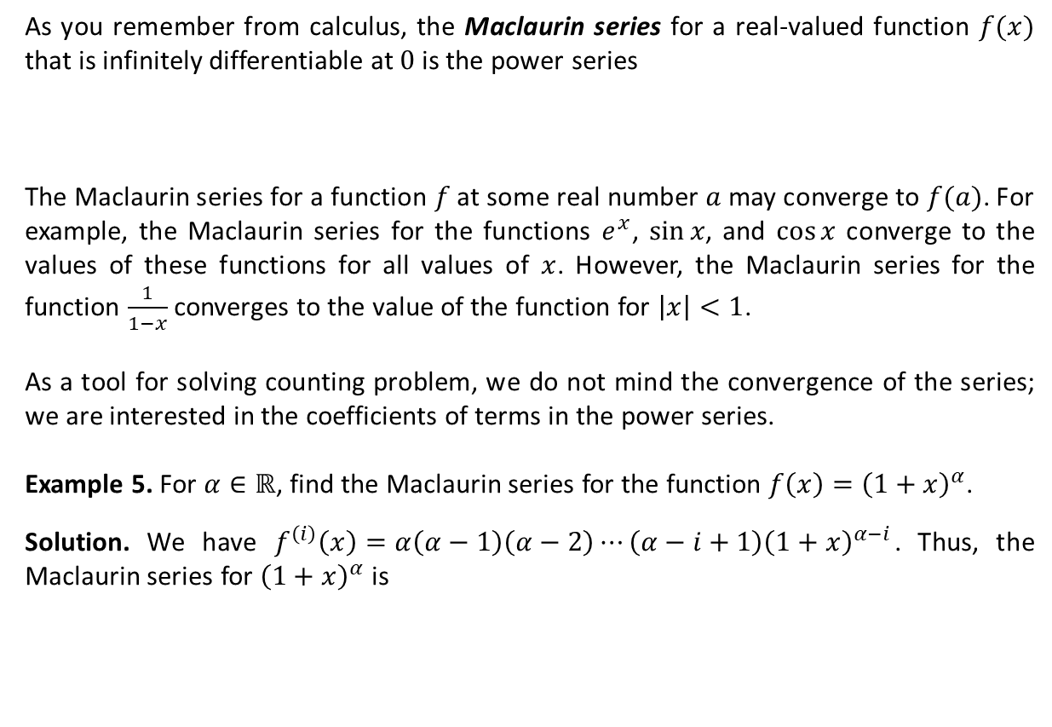

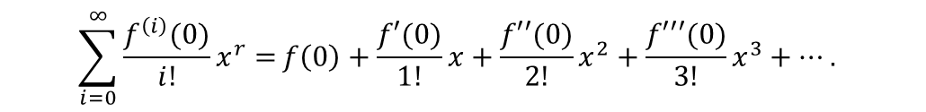
Maclaurin Series and Generating Functions
As you remember from calculus, the Maclaurin series for a real-valued function $f(x)$ that is infinitely differentiable at $0$ is the power series
The Maclaurin series for a function $f$ at some real number $a$ may converge to $f(a)$. For example, the Maclaurin series for the functions $e^{x}$, $\sin{x}$, and $\cos{x}$ converge to the values of these functions for all values of $x$. However, the Maclaurin series for the function $\frac{1}{1−x}$ converges to the value of the function for $\left|x\right|<1$.
As a tool for solving counting problem, we do not mind the convergence of the series; we are interested in the coefficients of terms in the power series.
Example 5. For $α∈ℝ$, find the Maclaurin series for the function $f\left(x\right)={\left(1+x\right)}^{α}$.
Solution. We have $f^{\left(i\right)}\left(x\right)=α\left(α−1\right)\left(α−2\right)⋯\left(α−i+1\right){\left(1+x\right)}^{α−i}$. Thus, the Maclaurin series for ${\left(1+x\right)}^{α}$ is
$$\sum_{i=0}^{∞}{\frac{f^{\left(i\right)}(0)}{i!}x^{r}=}f\left(0\right)+\frac{f′(0)}{1!}x+\frac{f′′(0)}{2!}x^{2}+\frac{f′′′(0)}{3!}x^{3}+….$$
$$\sum_{i=0}^{∞}{\frac{α\left(α−1\right)\left(α−2\right)⋯\left(α−i+1\right)}{i!}x^{i}=}\sum_{i=0}^{∞}{\left(\begin{matrix}α \\ i\end{matrix}\right)x^{i}.}$$

Slide 9
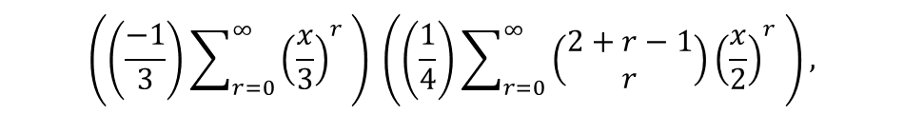

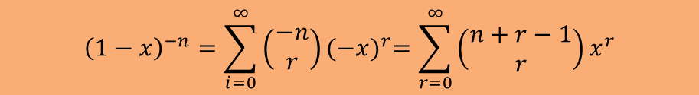
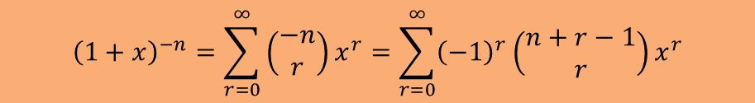
Maclaurin Series and Generating Functions (Ctd.)
In particular, for $n∈ℤ^{+}$, we have
Example 6. Determine the coefficient of $x^{8}$ in (the Maclaurin series for) $\frac{1}{\left(x−3\right){\left(x−2\right)}^{2}}$.
Solution. As a first solution, we can find the coefficient of $x^{8}$ in the product of the Maclaurin series for $\frac{1}{x−3}$ and that for $\frac{1}{{\left(x−2\right)}^{2}}$. The terms $\frac{1}{x−3}$ and $\frac{1}{{\left(x−2\right)}^{2}}$ can respectively be written as $\left(\frac{−1}{3}\right)\frac{1}{1−\frac{x}{3}}$ and $\left(\frac{1}{4}\right)\frac{1}{{\left(1−\frac{x}{2}\right)}^{2}}.$ Therefore, we should calculate the coefficient of $x^{8}$ in
which is equal to
$${\left(1+x\right)}^{−n}=\sum_{r=0}^{∞}{\left(\begin{matrix}−n \\ r\end{matrix}\right)}x^{r}=\sum_{r=0}^{∞}{{\left(−1\right)}^{r}\left(\begin{matrix}n+r−1 \\ r\end{matrix}\right)}x^{r}$$
$${\left(1−x\right)}^{−n}=\sum_{i=0}^{∞}{\left(\begin{matrix}−n \\ r\end{matrix}\right)}{(−x)}^{r}=\sum_{r=0}^{∞}{\left(\begin{matrix}n+r−1 \\ r\end{matrix}\right)}x^{r}$$
$$\left(\left(\frac{−1}{3}\right)\sum_{r=0}^{∞}{{\left(\frac{x}{3}\right)}^{r} }\right) \left(\left(\frac{1}{4}\right)\sum_{r=0}^{∞}{{\left(\begin{matrix}2+r−1 \\ r\end{matrix}\right)\left(\frac{x}{2}\right)}^{r} }\right),$$
$$\left(\frac{−1}{12}\right)\left(\frac{1}{3^{0}}⋅\left(\begin{matrix}9 \\ 8\end{matrix}\right)⋅\frac{1}{2^{8}}+\frac{1}{3}⋅\left(\begin{matrix}8 \\ 7\end{matrix}\right)⋅\frac{1}{2^{7}}+\frac{1}{3^{2}}⋅\left(\begin{matrix}7 \\ 6\end{matrix}\right)⋅\frac{1}{2^{6}}+…+\frac{1}{3^{8}}⋅\left(\begin{matrix}1 \\ 0\end{matrix}\right)⋅\frac{1}{2^{0}}\right).$$

Slide 10
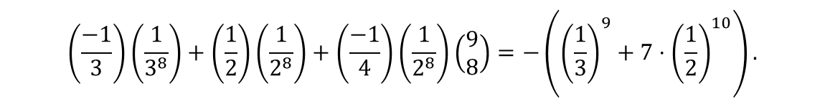



Maclaurin Series and Generating Functions (Ctd.)
Another solution is the use of the partial fraction decomposition.
This implies
or $A=1$, $B=−1$, and $C=−1$. Thus, the coefficient of $x^{8}$ in $\frac{1}{\left(x−3\right){\left(x−2\right)}^{2}}$ equals the coefficient of $x^{8}$ in
which is equal to
$$\frac{1}{\left(x−3\right){\left(x−2\right)}^{2}}=\frac{A}{x−3}+\frac{B}{x−2}+\frac{C}{{\left(x−2\right)}^{2}}$$
$1=A{\left(x−2\right)}^{2}+B(x−3)\left(x−2\right)+C(x−3)$,
$$\left(\frac{−1}{3}\right)\sum_{r=0}^{∞}{{\left(\frac{x}{3}\right)}^{r} }+\left(\frac{1}{2}\right)\sum_{r=0}^{∞}{{\left(\frac{x}{2}\right)}^{r}+}\left(\frac{−1}{4}\right)\sum_{r=0}^{∞}{{\left(\begin{matrix}2+r−1 \\ r\end{matrix}\right)\left(\frac{x}{2}\right)}^{r} },$$
$$\left(\frac{−1}{3}\right)\left(\frac{1}{3^{8}}\right)+\left(\frac{1}{2}\right)\left(\frac{1}{2^{8}}\right)+\left(\frac{−1}{4}\right)\left(\frac{1}{2^{8}}\right)\left(\begin{matrix}9 \\ 8\end{matrix}\right)=−\left({\left(\frac{1}{3}\right)}^{9}+7⋅{\left(\frac{1}{2}\right)}^{10}\right).$$

Slide 11
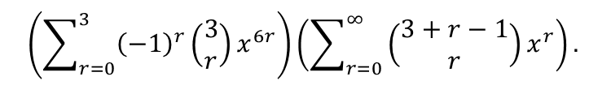

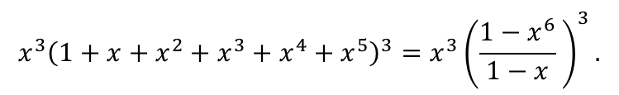
Application to Counting Problems
Example 7. In how many ways can one get the sum of $14$ when he/she rolls a single die $3$ times?
Solution. The answer is the coefficient of $x^{14}$ in
which is equal to
Thus, we should find the coefficient of $x^{14}$ in ${\left(1−x^{6}\right)}^{3}\frac{1}{{\left(1−x\right)}^{3}}$, that is in
It is equal to
$(x+x^{2}+…+x^{6})(x+x^{2}+…+x^{6})$ $\left(x+x^{2}+…+x^{6}\right)$,
$$x^{3}{\left(1+x+x^{2}+x^{3}+x^{4}+x^{5}\right)}^{3}=x^{3}{\left(\frac{1−x^{6}}{1−x} \right)}^{3}.$$
$$\left(\sum_{r=0}^{3}{{\left(−1\right)}^{r}\left(\begin{matrix}3 \\ r\end{matrix}\right)}x^{6r}\right)\left(\sum_{r=0}^{∞}{\left(\begin{matrix}3+r−1 \\ r\end{matrix}\right)x^{r}}\right).$$
$${\left(−1\right)}^{0}\left(\begin{matrix}3 \\ 0\end{matrix}\right)\left(\begin{matrix}3+10−1 \\ 10\end{matrix}\right)+{\left(−1\right)}^{1}\left(\begin{matrix}3 \\ 1\end{matrix}\right)\left(\begin{matrix}3+4−1 \\ 4\end{matrix}\right)+{\left(−1\right)}^{2}\left(\begin{matrix}3 \\ 2\end{matrix}\right)\left(\begin{matrix}3+2−1 \\ 3\end{matrix}\right)=33$$

Slide 12

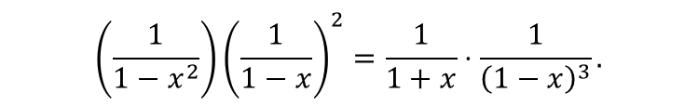
Application to Counting Problems (Ctd.)
Example 8. In how many ways can Traci select $n$ marbles from a large supply of blue, red, and yellow marbles (all of the same size) if the selection must include an even number of blue ones?
Solution. The answer is the coefficient of $x^{n}$ in
which is equal to
By the technique of partial fraction decomposition, we have
Thus, the answer is
$\left(1+x^{2}+x^{4}+…\right){\left(1+x+x^{2}+…\right)}^{2}$,
$$\left(\frac{1}{1−x^{2}}\right){\left(\frac{1}{1−x}\right)}^{2}=\frac{1}{1+x}⋅\frac{1}{{\left(1−x\right)}^{3}}.$$
$$\frac{1}{1+x}⋅\frac{1}{{\left(1−x\right)}^{3}}=\left(\frac{1}{8}\right)\frac{1}{1+x}+\left(\frac{1}{8}\right)\frac{1}{1−x}+\left(\frac{1}{4}\right)\frac{1}{{\left(1−x\right)}^{2}}+\left(\frac{1}{2}\right)\frac{1}{{\left(1−x\right)}^{3}}.$$
$$\left(\frac{1}{8}\right)\left({\left(−1\right)}^{n}+1\right)+\left(\frac{1}{4}\right)\left(\begin{matrix}2+n−1 \\ n\end{matrix}\right)+\left(\frac{1}{2}\right)\left(\begin{matrix}3+n−1 \\ n\end{matrix}\right)=\frac{2n^{2}+8n+7+{\left(−1\right)}^{n}}{8}.$$

Slide 13
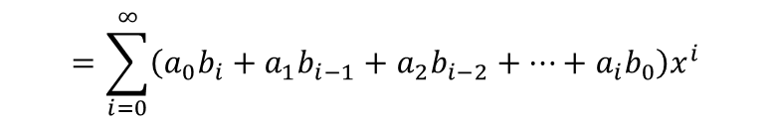

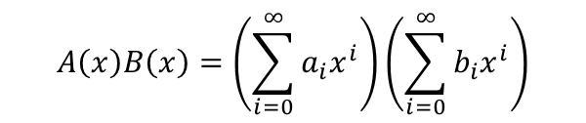
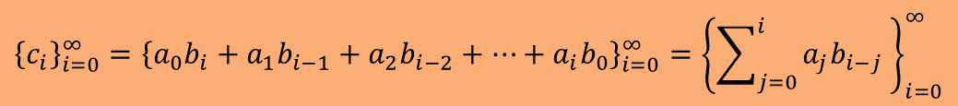

Convolution of Sequences
Let ${\left\{a_{i}\right\}}_{i=0}^{∞}$ and ${\left\{b_{i}\right\}}_{i=0}^{∞}$ be two sequences whose generating functions are $A(x)$ and $B(x)$, respectively. It is clear that the function $A\left(x\right)+B(x)$ is the generating function for the sequence ${\left\{c_{i}\right\}}_{i=0}^{∞}={\left\{a_{i}+b_{i}\right\}}_{i=0}^{∞}$.
What about $A\left(x\right)B(x)$?
We have
Thus, $A\left(x\right)B(x)$ is the generating function for the sequence
This sequence is called the convolution of sequences ${\left\{a_{i}\right\}}_{i=0}^{∞}$ and ${\left\{b_{i}\right\}}_{i=0}^{∞}$.
$$A\left(x\right)B\left(x\right)=\left(\sum_{i=0}^{∞}{a_{i}x^{i}}\right)\left(\sum_{i=0}^{∞}{b_{i}x^{i}}\right)$$
$$=(a_{0}+a_{1}x+a_{2}x^{2}+…)(b_{0}+b_{1}x+b_{2}x^{2}+…)$$
$$=a_{0}b_{0}+\left(a_{0}b_{1}+a_{1}b_{0}\right)x+\left(a_{0}b_{2}+a_{1}b_{1}+a_{2}b_{0}\right)x^{2}+…$$
$$=\sum_{i=0}^{∞}{\left(a_{0}b_{i}+a_{1}b_{i−1}+a_{2}b_{i−2}+…+a_{i}b_{0}\right)x^{i}}$$
$$=\sum_{i=0}^{∞ }{\left(\sum_{j=0}^{i}{a_{j}b_{i−j} }\right) x^{i}}$$
$${\left\{c_{i}\right\}}_{i=0}^{∞}={{\left\{a_{0}b_{i}+a_{1}b_{i−1}+a_{2}b_{i−2}+…+a_{i}b_{0}\right\}}_{i=0}^{∞}=\left\{\sum_{j=0}^{i}{a_{j}b_{i−j} }\right\}}_{i=0}^{∞}$$

Slide 14
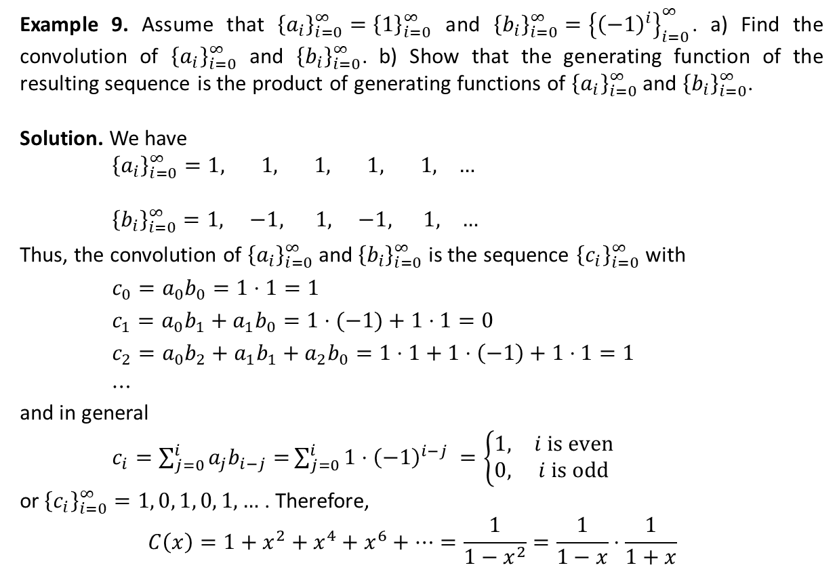
Convolution of Sequences (Ctd.)
Example 9. Assume that ${\left\{a_{i}\right\}}_{i=0}^{∞}={\left\{1\right\}}_{i=0}^{∞}$ and ${\left\{b_{i}\right\}}_{i=0}^{∞}={\left\{{\left(−1\right)}^{i}\right\}}_{i=0}^{∞}$. a) Find the convolution of ${\left\{a_{i}\right\}}_{i=0}^{∞}$ and ${\left\{b_{i}\right\}}_{i=0}^{∞}$. b) Show that the generating function of the resulting sequence is the product of generating functions of ${\left\{a_{i}\right\}}_{i=0}^{∞}$ and ${\left\{b_{i}\right\}}_{i=0}^{∞}$.
Solution. We have
${\left\{a_{i}\right\}}_{i=0}^{∞}=1, 1, 1, 1, 1, …$
${\left\{b_{i}\right\}}_{i=0}^{∞}=1, −1, 1, −1, 1, …$
Thus, the convolution of ${\left\{a_{i}\right\}}_{i=0}^{∞}$ and ${\left\{b_{i}\right\}}_{i=0}^{∞}$ is the sequence ${\left\{c_{i}\right\}}_{i=0}^{∞}$ with
$c_{0}=a_{0}b_{0}=1⋅1=1$
$c_{1}=a_{0}b_{1}+a_{1}b_{0}=1⋅(−1)+1⋅1=0$
$c_{2}=a_{0}b_{2}+a_{1}b_{1}+a_{2}b_{0}=1⋅1+1⋅\left(−1\right)+1⋅1=1$
$⋯$
and in general
$c_{i}=\sum_{j=0}^{i}{a_{j}b_{i−j}=}\sum_{j=0}^{i}{1⋅{\left(−1\right)}^{i−j} =\left\{\begin{matrix}1, & i is even \\ 0, & i is odd\end{matrix}\right.}$
or${\left\{c_{i}\right\}}_{i=0}^{∞}=1, 0, 1, 0, 1, …$ . Therefore,
$$C\left(x\right)=1+x^{2}+x^{4}+x^{6}+…=\frac{1}{1−x^{2}}=\frac{1}{1−x}⋅\frac{1}{1+x}$$

Slide 15
Textbook: Ralph P. Grimaldi, Discrete and Combinatorial Mathematics
You may begin doing exercises of Chapter 9.

